Slide 1

Welcome
Stakeholder Mapping & Real Life Prototyping

Slide 2
Housekeeping Rules
This is an interactive Zoom session, let's use some cool features Zoom comes with
Start by renaming yourself in the participants list (Name-Team Number/Name)
The session is being recorded.
All tools, slides and the recording will be made available for you in our Google Classroom
Do you have a question/contribution? Raise your hand or use the chat box :)
Welcome to Week 1

Slide 3

Storytelling: Once upon a time…
I start sharing a story but want you to help me telling it. Everyone can just add a few sentences and help the story being told. Let’s use our fantasy!

Slide 4
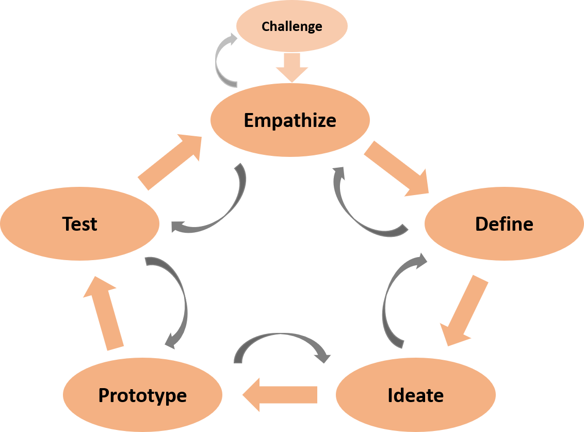

Slide 5
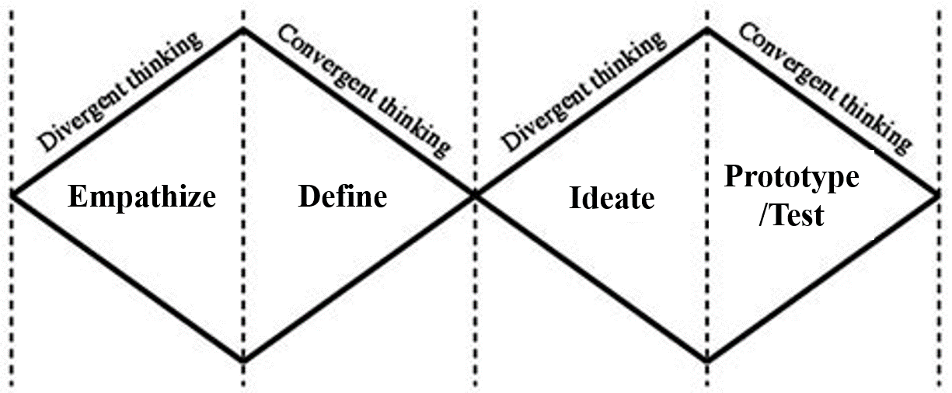
After Testing: Iterate

Slide 6
30 Minutes
5 minutes / per team
Present Your New Prototype
Feel free to share your screen!

Slide 7
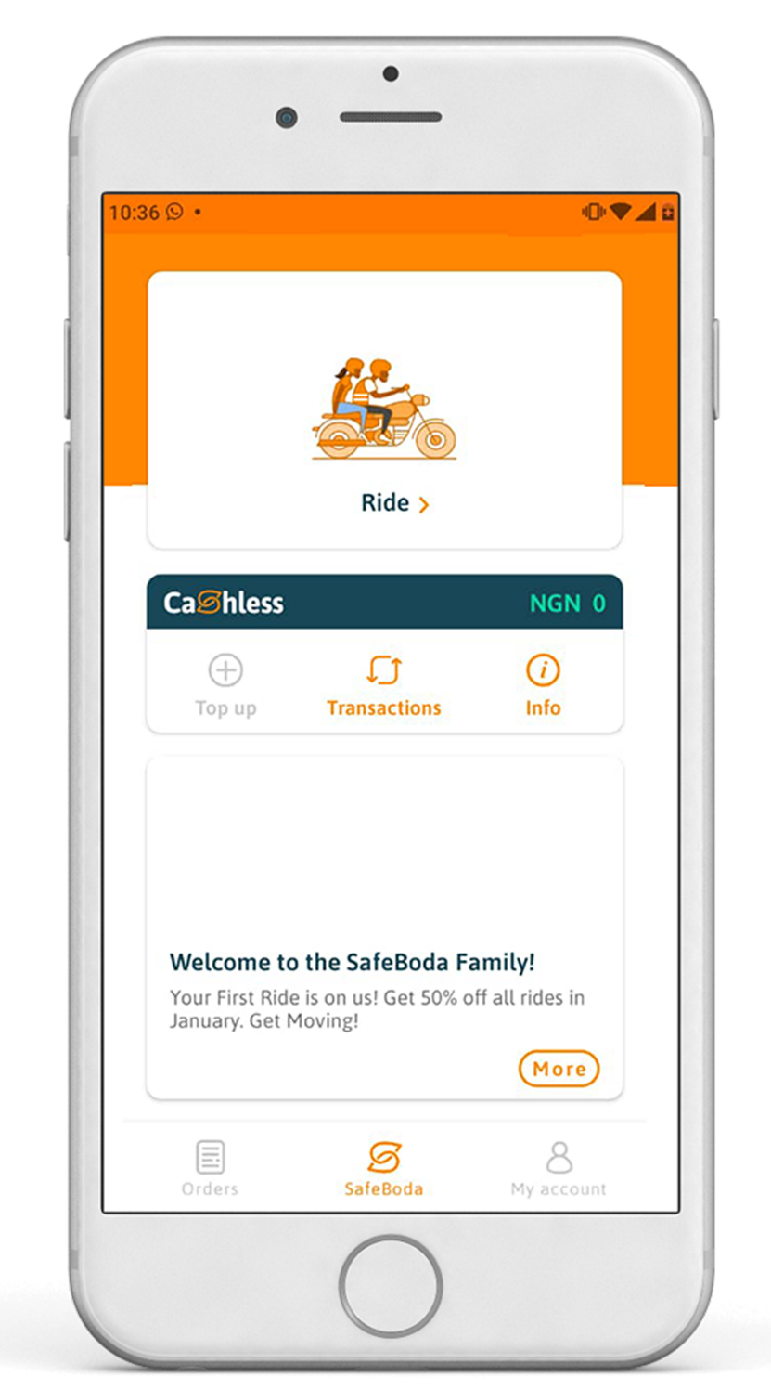
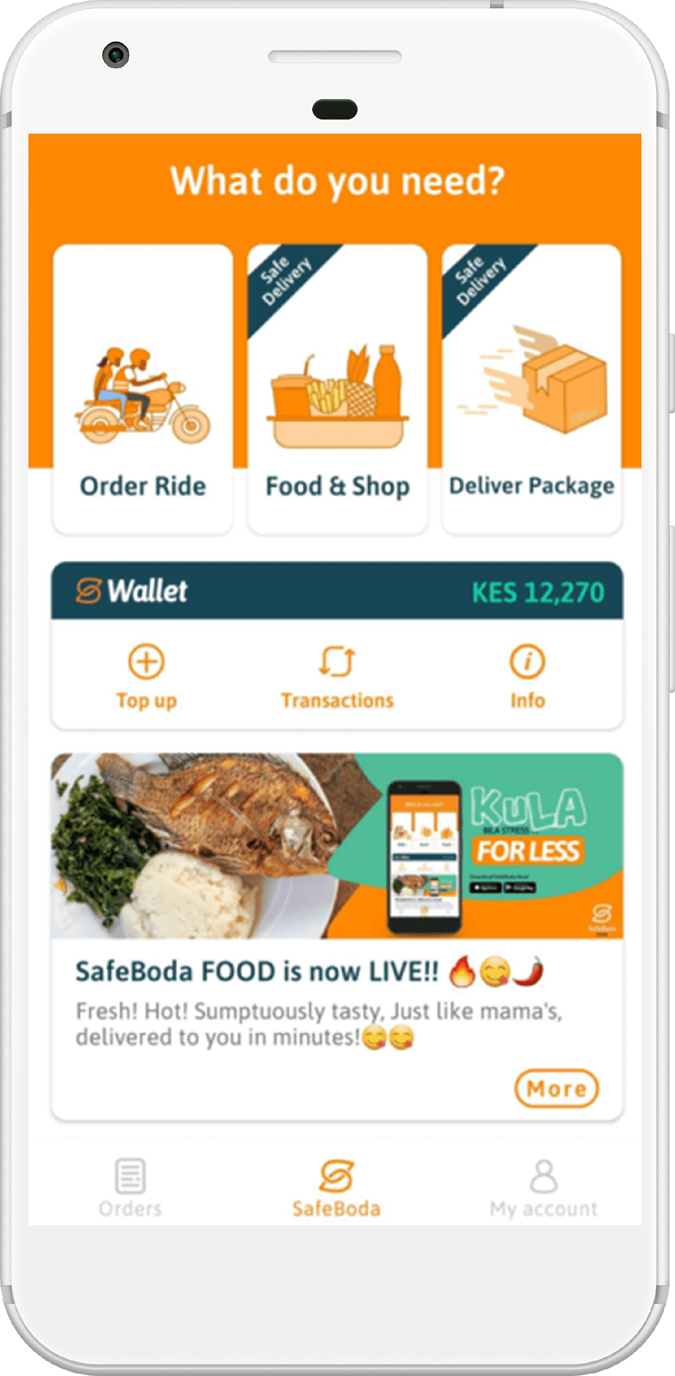
Where to Start?
Start with designing your most critical function!

Slide 8














Real Life Prototyping
SafeBoda Customers
SafeBoda Drivers
Cash?
SafeBoda Team

Slide 9
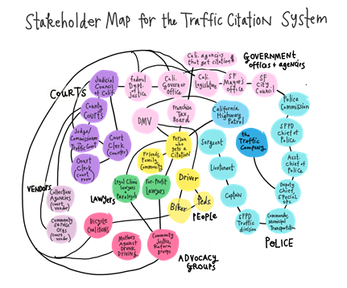
Stakeholder Mapping
Understanding the actively involved people by
thinking of individuals, organizations, companies etc. involved
creating an overview which shows relations between stakeholders
Graphic by Margaret Hagan (2017). URL: https://www.openlawlab.com/2017/08/28/stakeholder-mapping-the-traffic-ticket-system/

Slide 10
Breakout Rooms
15 minutes
Work Template
Preparations for Real-Life-Prototype Testing
Stakeholder Map: Who is involved?
The parking space owner.
The customers(car owners).
The parking space staff(valets & guards).
What do we need to make this happen? (Material, People etc.)
We need to invite and organize a meeting for all the stakeholders. We need to make prototypes for demonstration.
We need to publish user manuals for every stakeholder.
We need to a well gazetted area for demonstration.
How does the testing scenario look like?
We can organize an exhibition where we have our prototypes on display and we shall have to demonstrate to the car owners, parking staff and parking owner how they will be using and interacting with the whole system. Then after that we let the stakeholders to also use and interact with the whole system on how it works.
When & where do we want to test?
The meeting will be at the parking area in the evening when most of the customers are present.
The demonstrations of the prototypes will be with in the parking area.

Slide 11
Thank you
Have a great day ahead.

